Slide 1
NDTwin Network Digital Twin
Let the Outside Decide What to Test
Adam · 2026-09-16

Slide 2
REQUIREMENTS DRIVE THE TESTS
REQUIREMENTS DRIVE THE TESTS
the requirement comes from | what it is | what it drives | what it found
OUTSIDE PROGRAMS | 13 exercises in p4lang/tutorials — written by other people, and not for us | each exercise against 16 capability dimensions, then NDTwin against the same 16 | 5 real gaps · 2 findings only a foreign program exposes
OUTSIDE PEOPLE | six operators' motives — inherit, rush a paper, follow the handbook, collide, push traffic, restart | send each one at the machine and watch which untested pair of assumptions it crosses | two nights · 11 rounds · dozens of defects
the claim
WHY IT WORKS | a test we write walks the path its author already thought of — an outside requirement walks somewhere else, and that is where the defects live
2

Slide 3
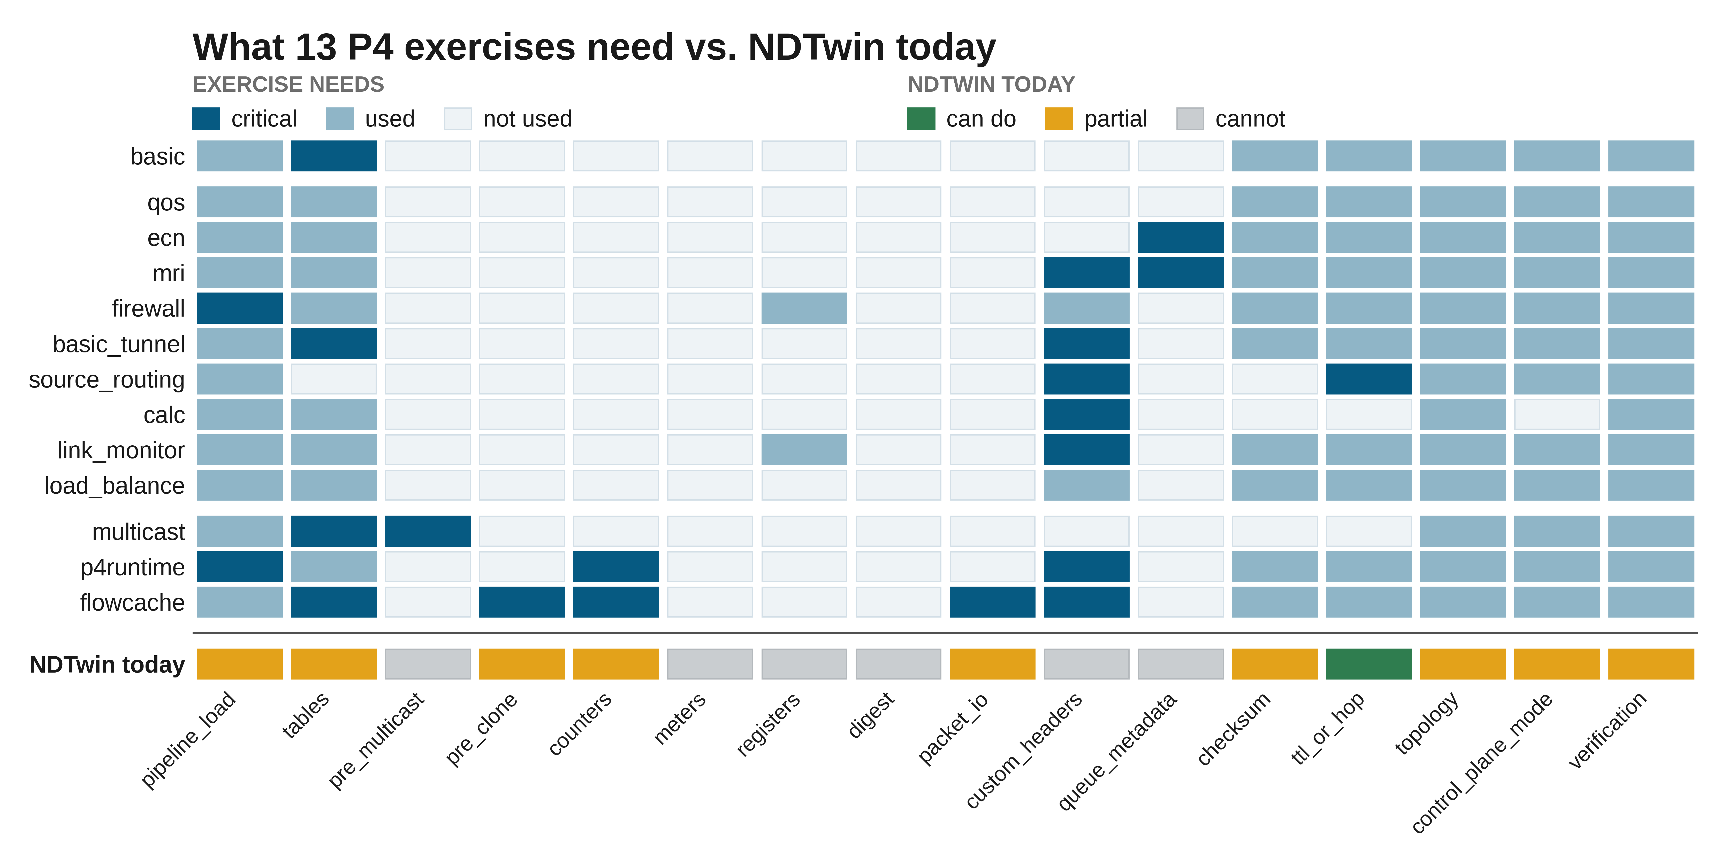
1 · REQUIREMENTS FROM OUTSIDE PROGRAMS
3

Slide 4
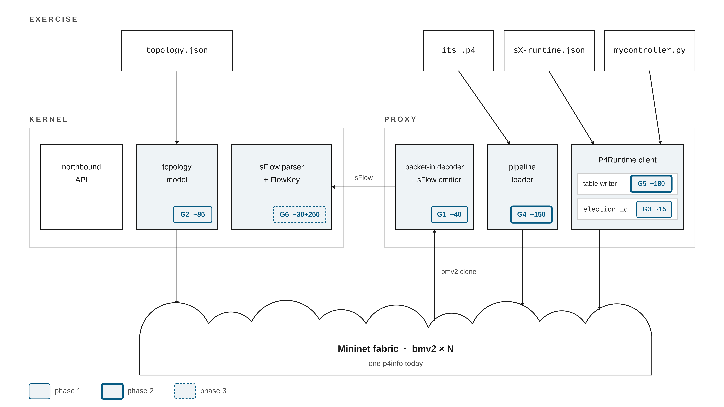
1 · REQUIREMENTS FROM OUTSIDE PROGRAMS
4

Slide 5
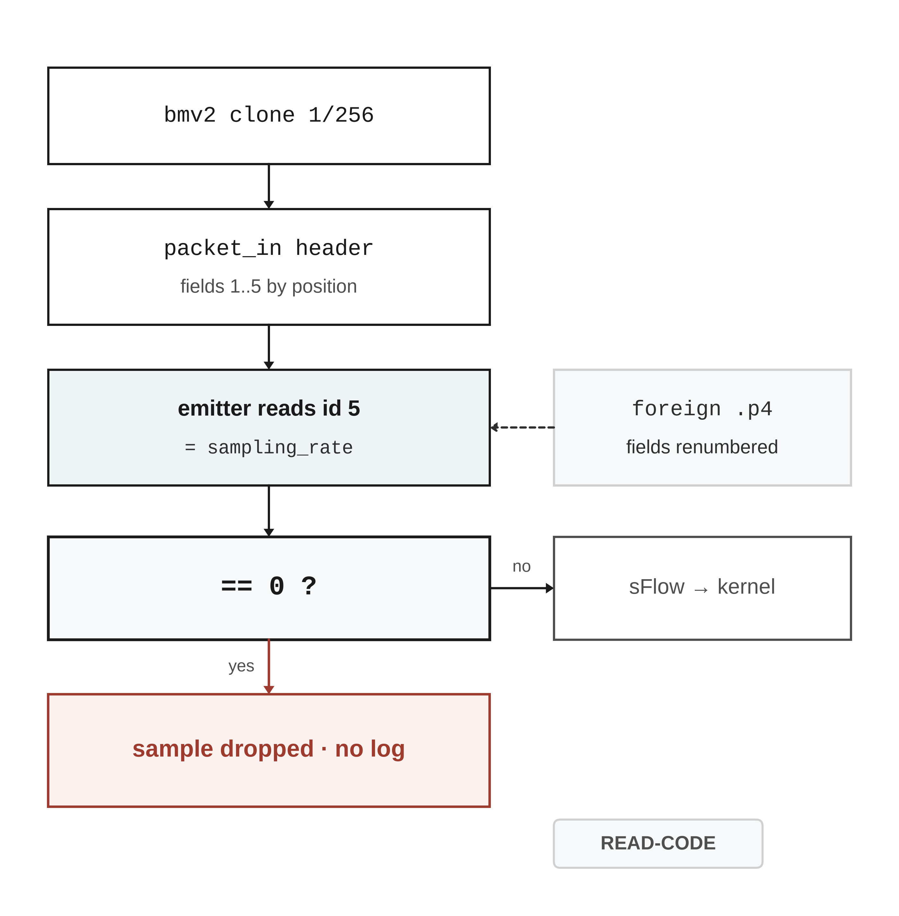
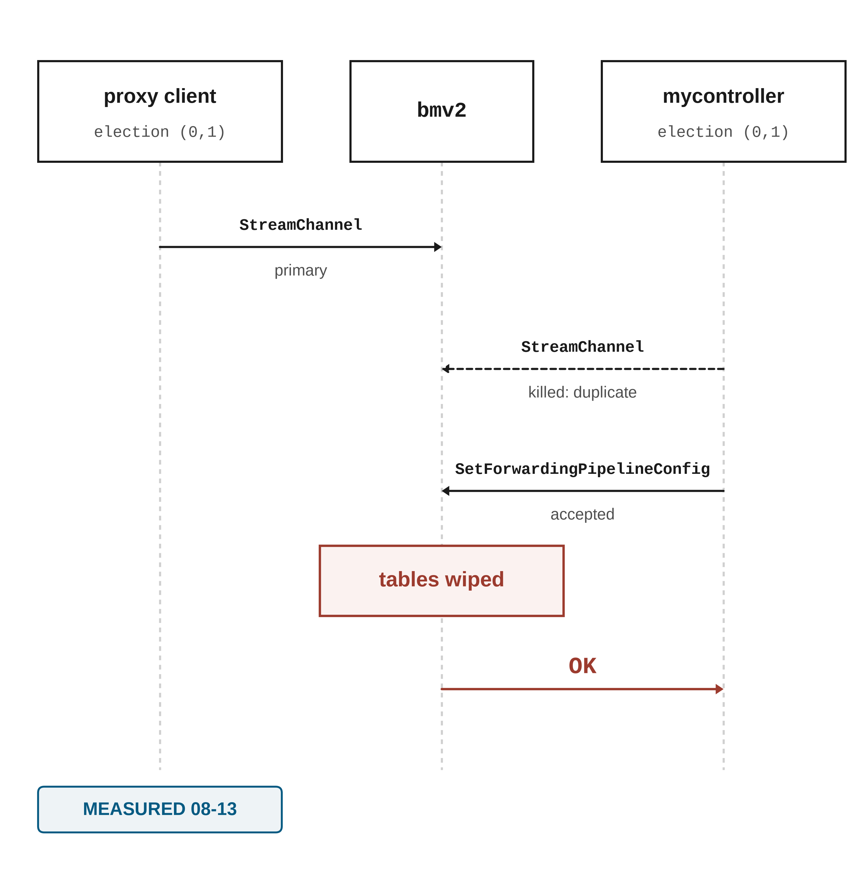
1 · REQUIREMENTS FROM OUTSIDE PROGRAMS
5

Slide 6
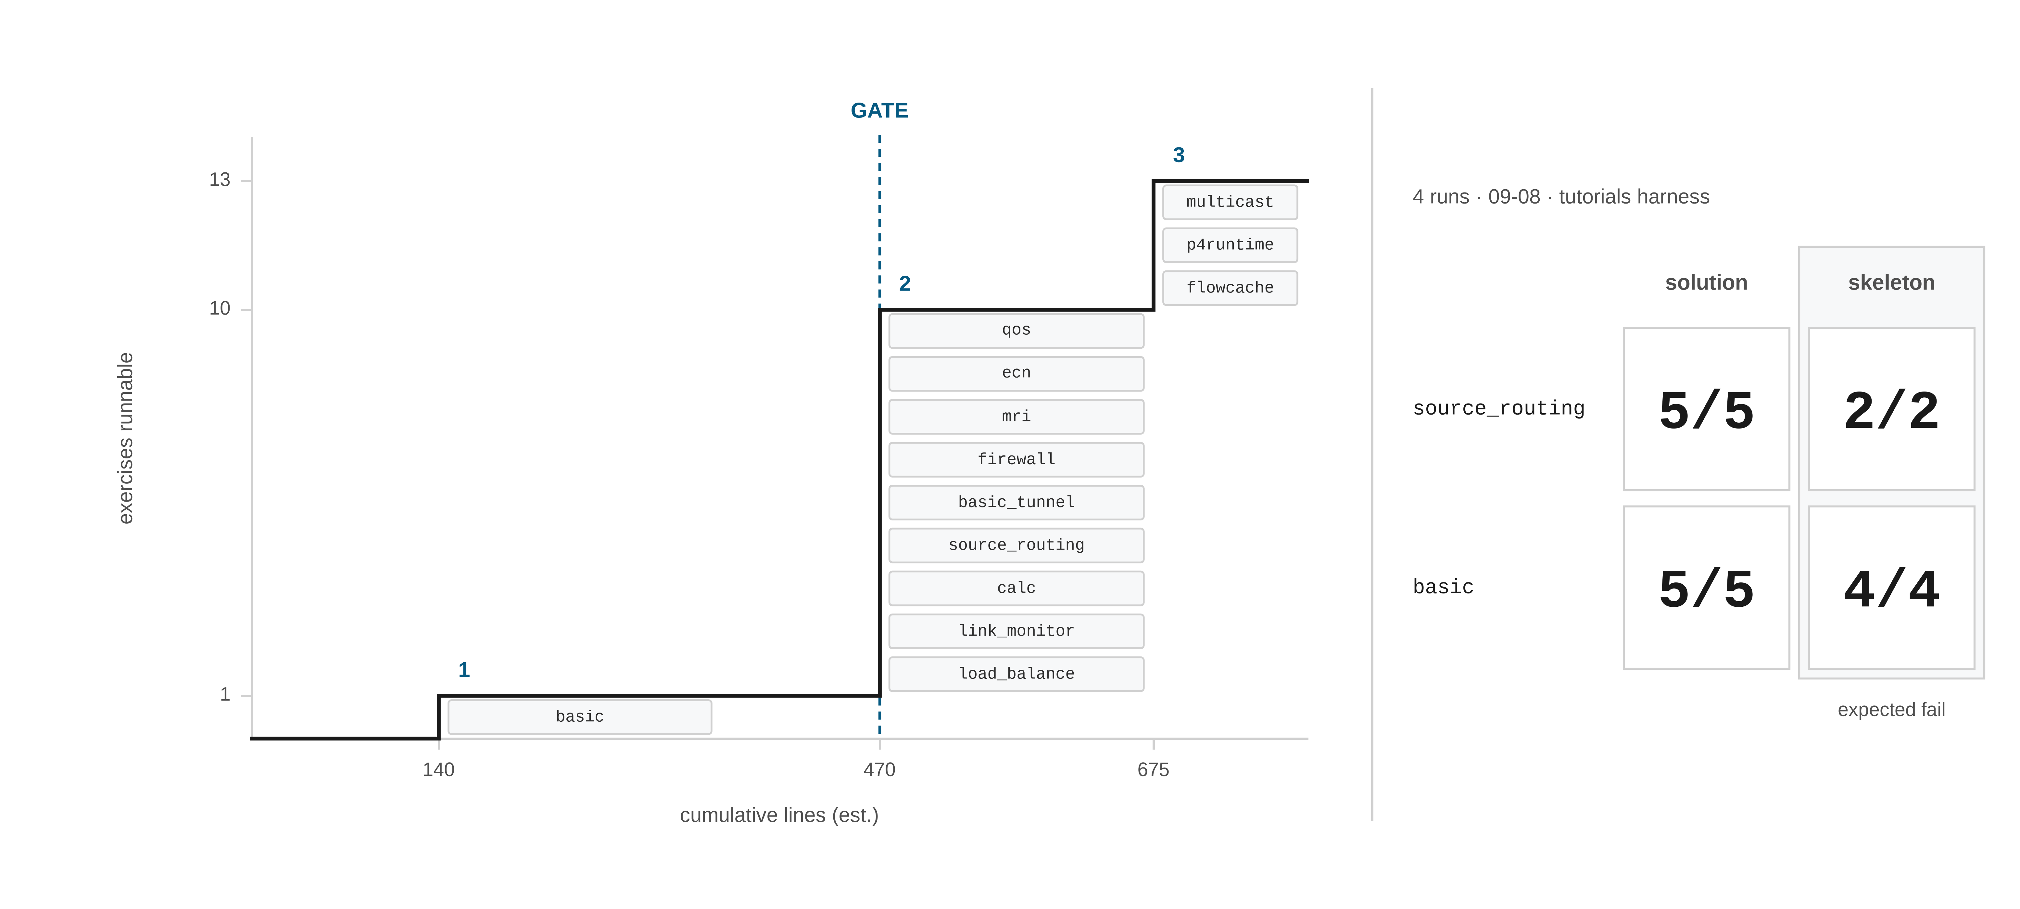
1 · REQUIREMENTS FROM OUTSIDE PROGRAMS
6

Slide 7
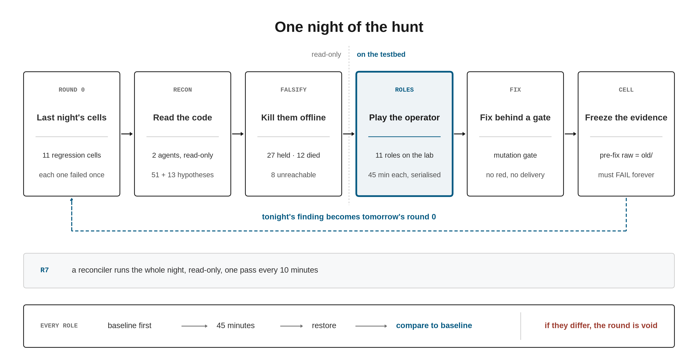
2 · REQUIREMENTS FROM OUTSIDE PEOPLE
7

Slide 8
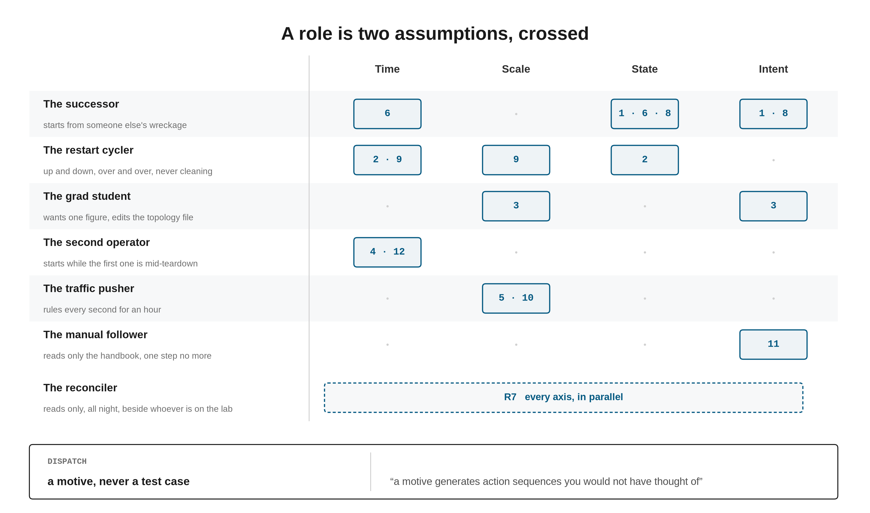
2 · REQUIREMENTS FROM OUTSIDE PEOPLE
8

Slide 9
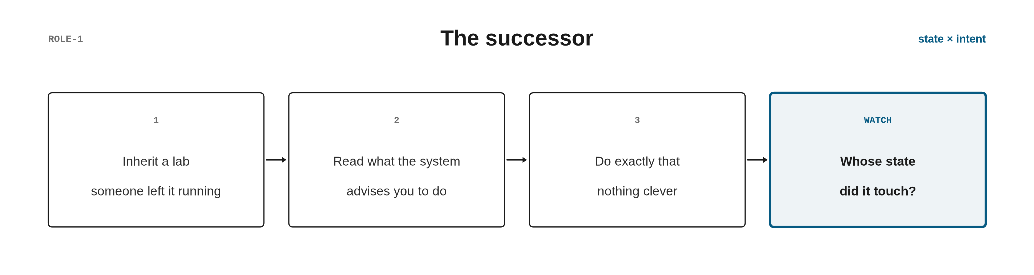
2 · REQUIREMENTS FROM OUTSIDE PEOPLE
9

Slide 10
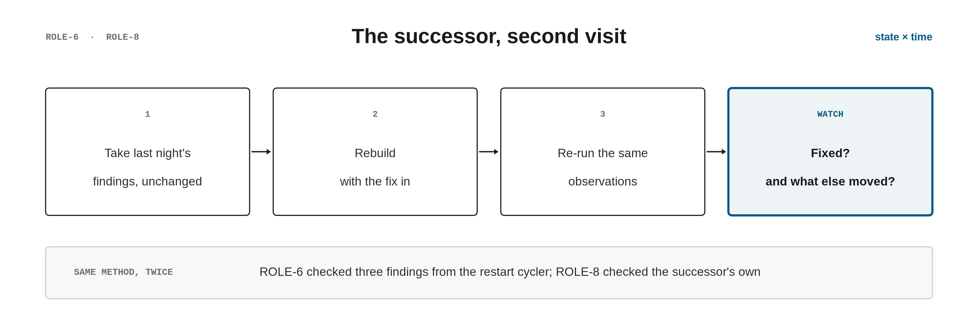
2 · REQUIREMENTS FROM OUTSIDE PEOPLE
10

Slide 11
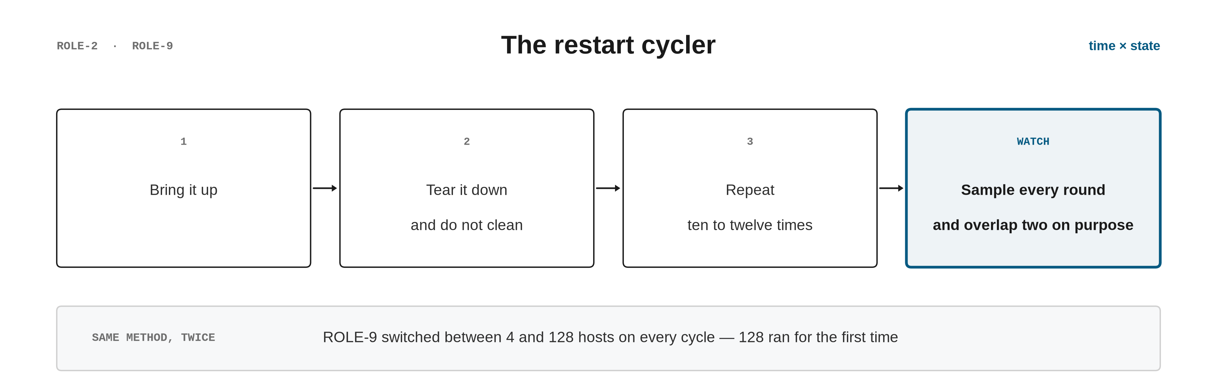
2 · REQUIREMENTS FROM OUTSIDE PEOPLE
11

Slide 12
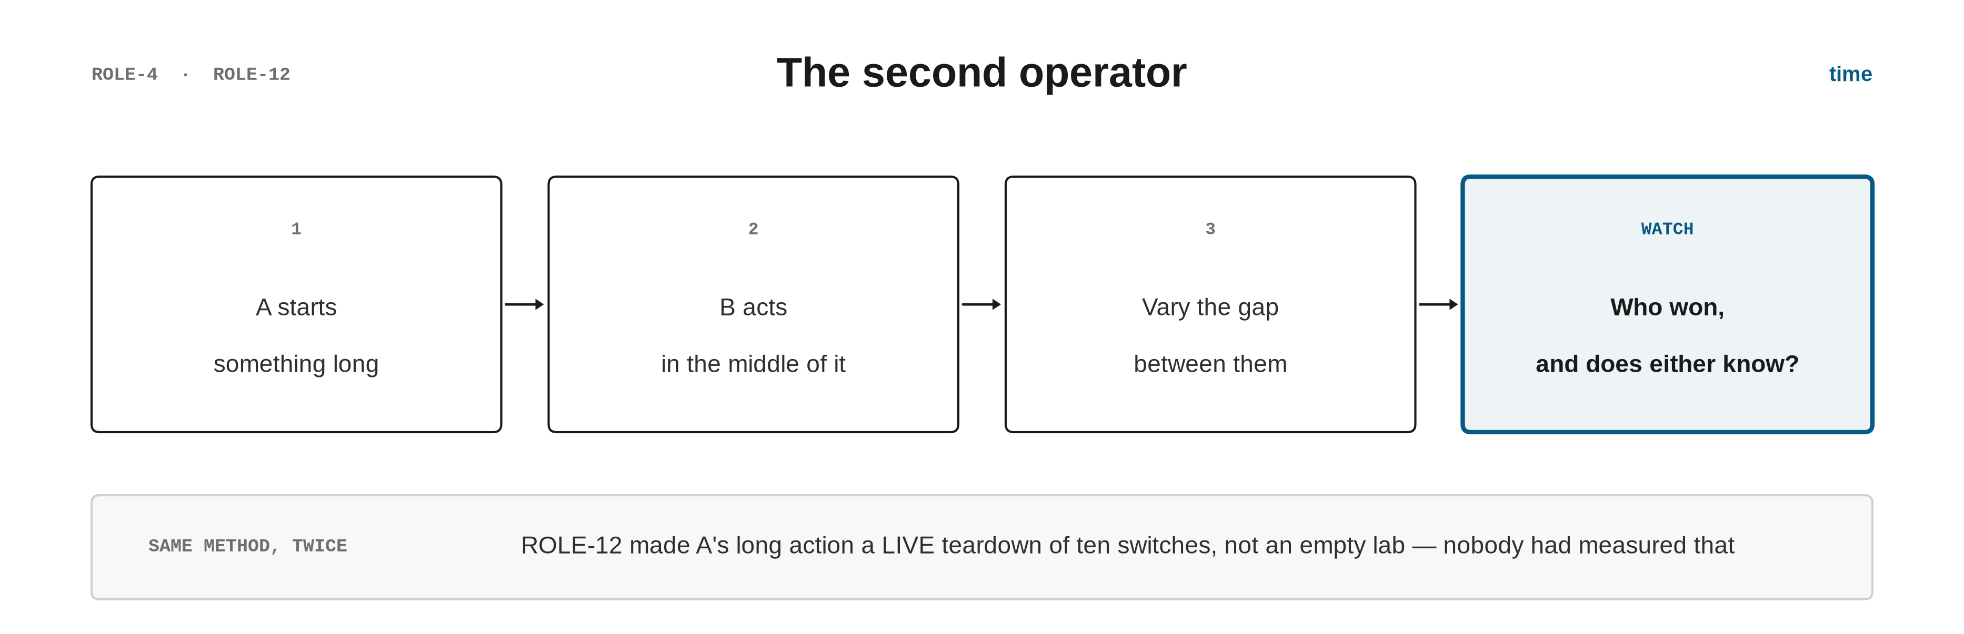
2 · REQUIREMENTS FROM OUTSIDE PEOPLE
12

Slide 13
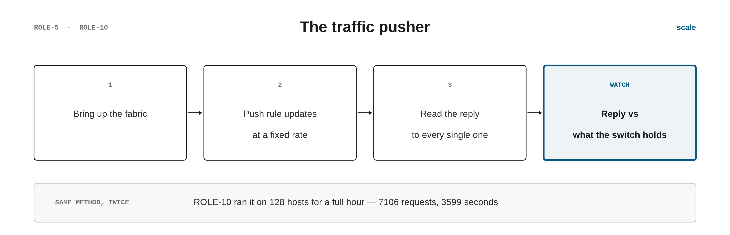
2 · REQUIREMENTS FROM OUTSIDE PEOPLE
13

Slide 14
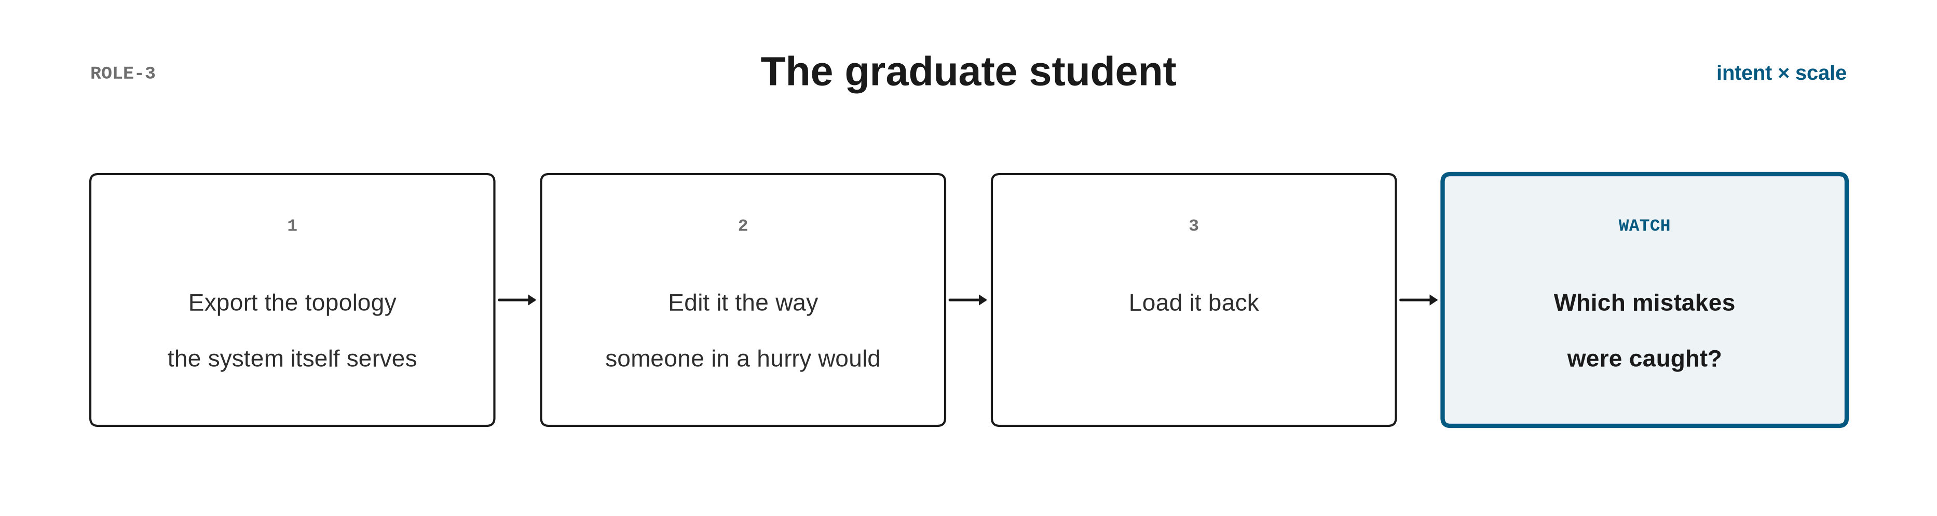
2 · REQUIREMENTS FROM OUTSIDE PEOPLE
14

Slide 15
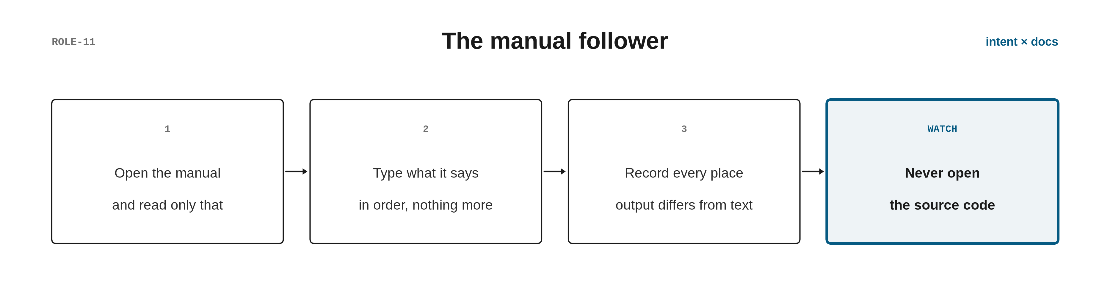
2 · REQUIREMENTS FROM OUTSIDE PEOPLE
15

Slide 16
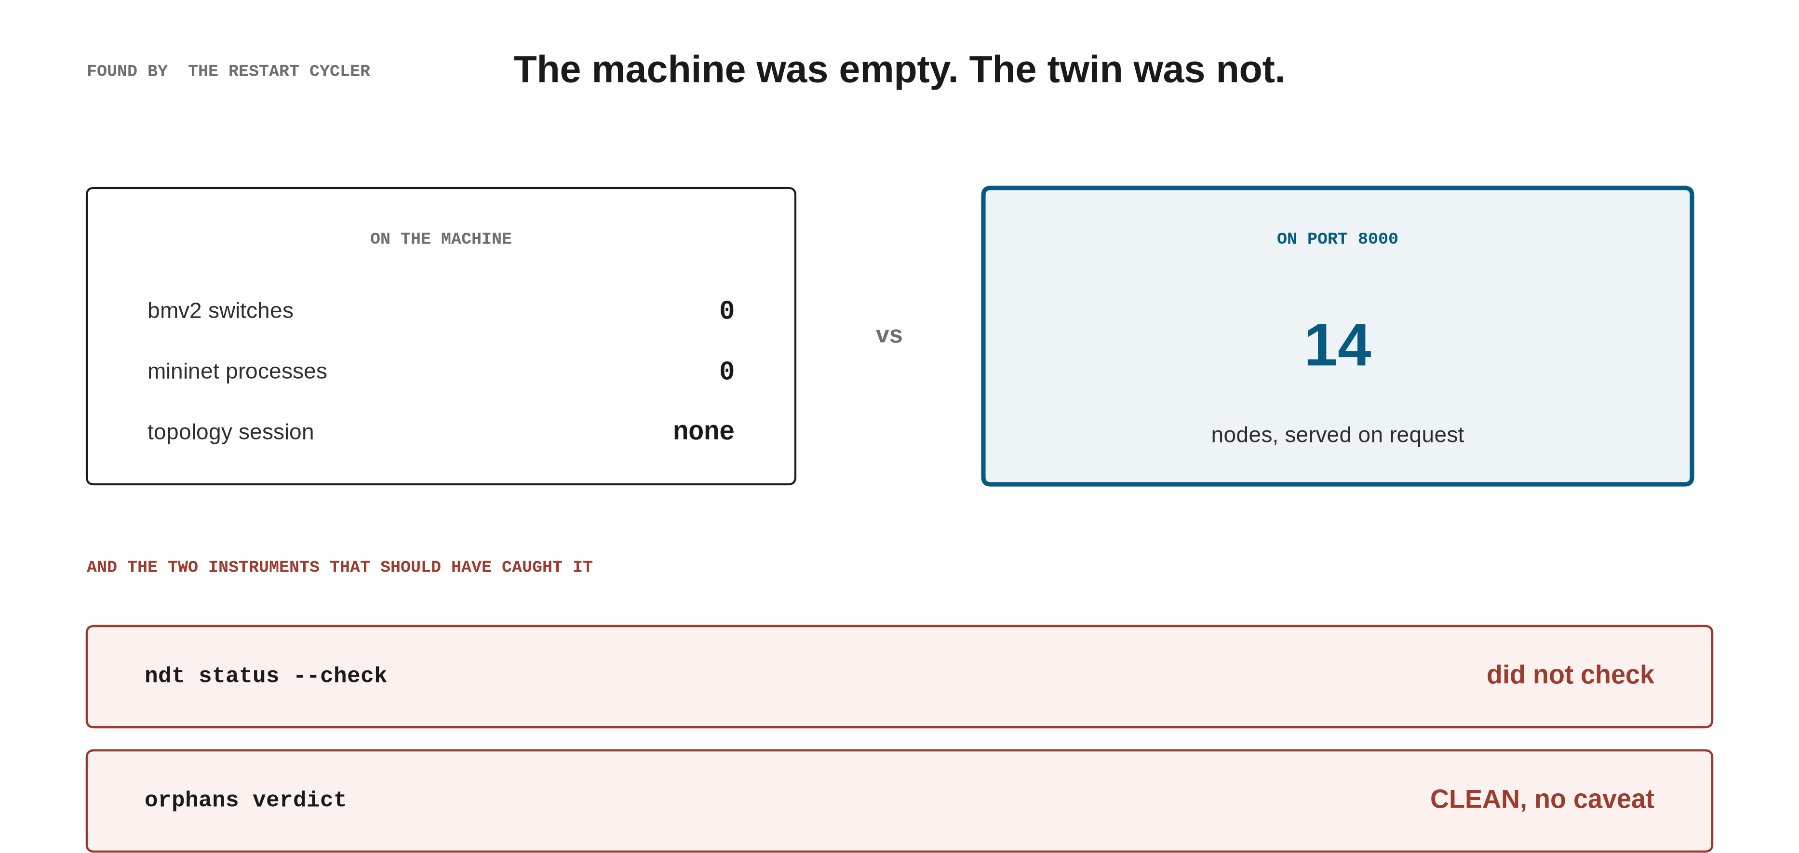
3 · WHAT THE ROLES FOUND
16

Slide 17
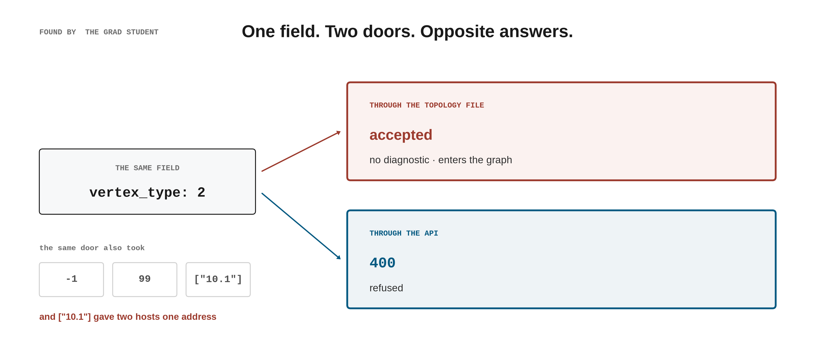
3 · WHAT THE ROLES FOUND
17

Slide 18
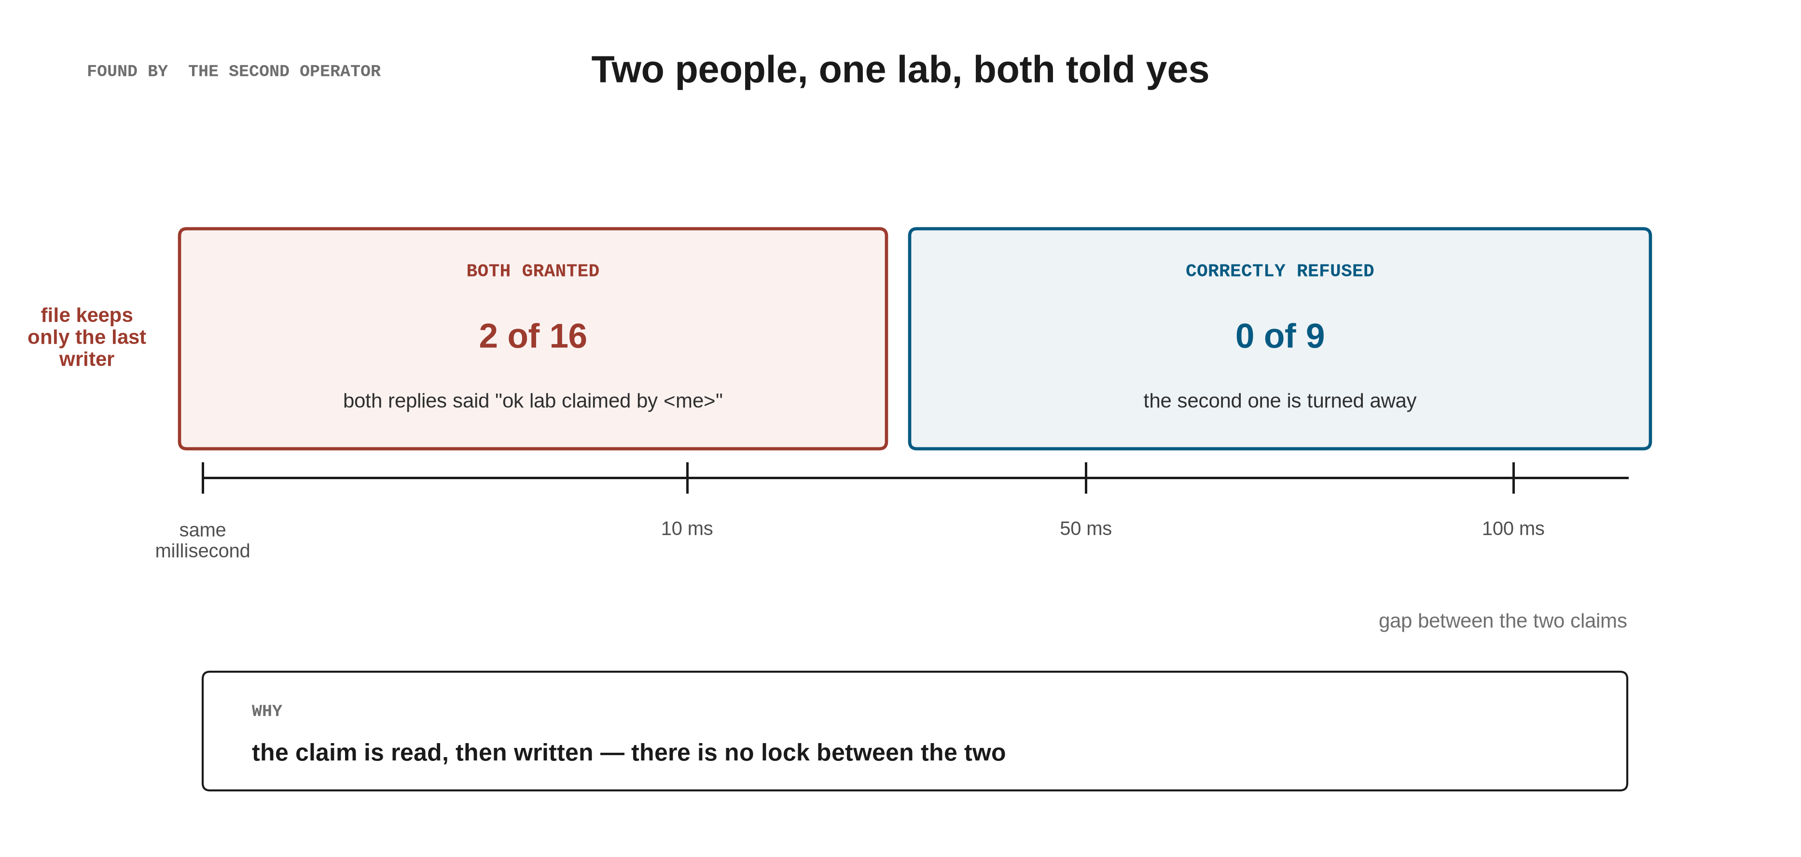
3 · WHAT THE ROLES FOUND
18

Slide 19
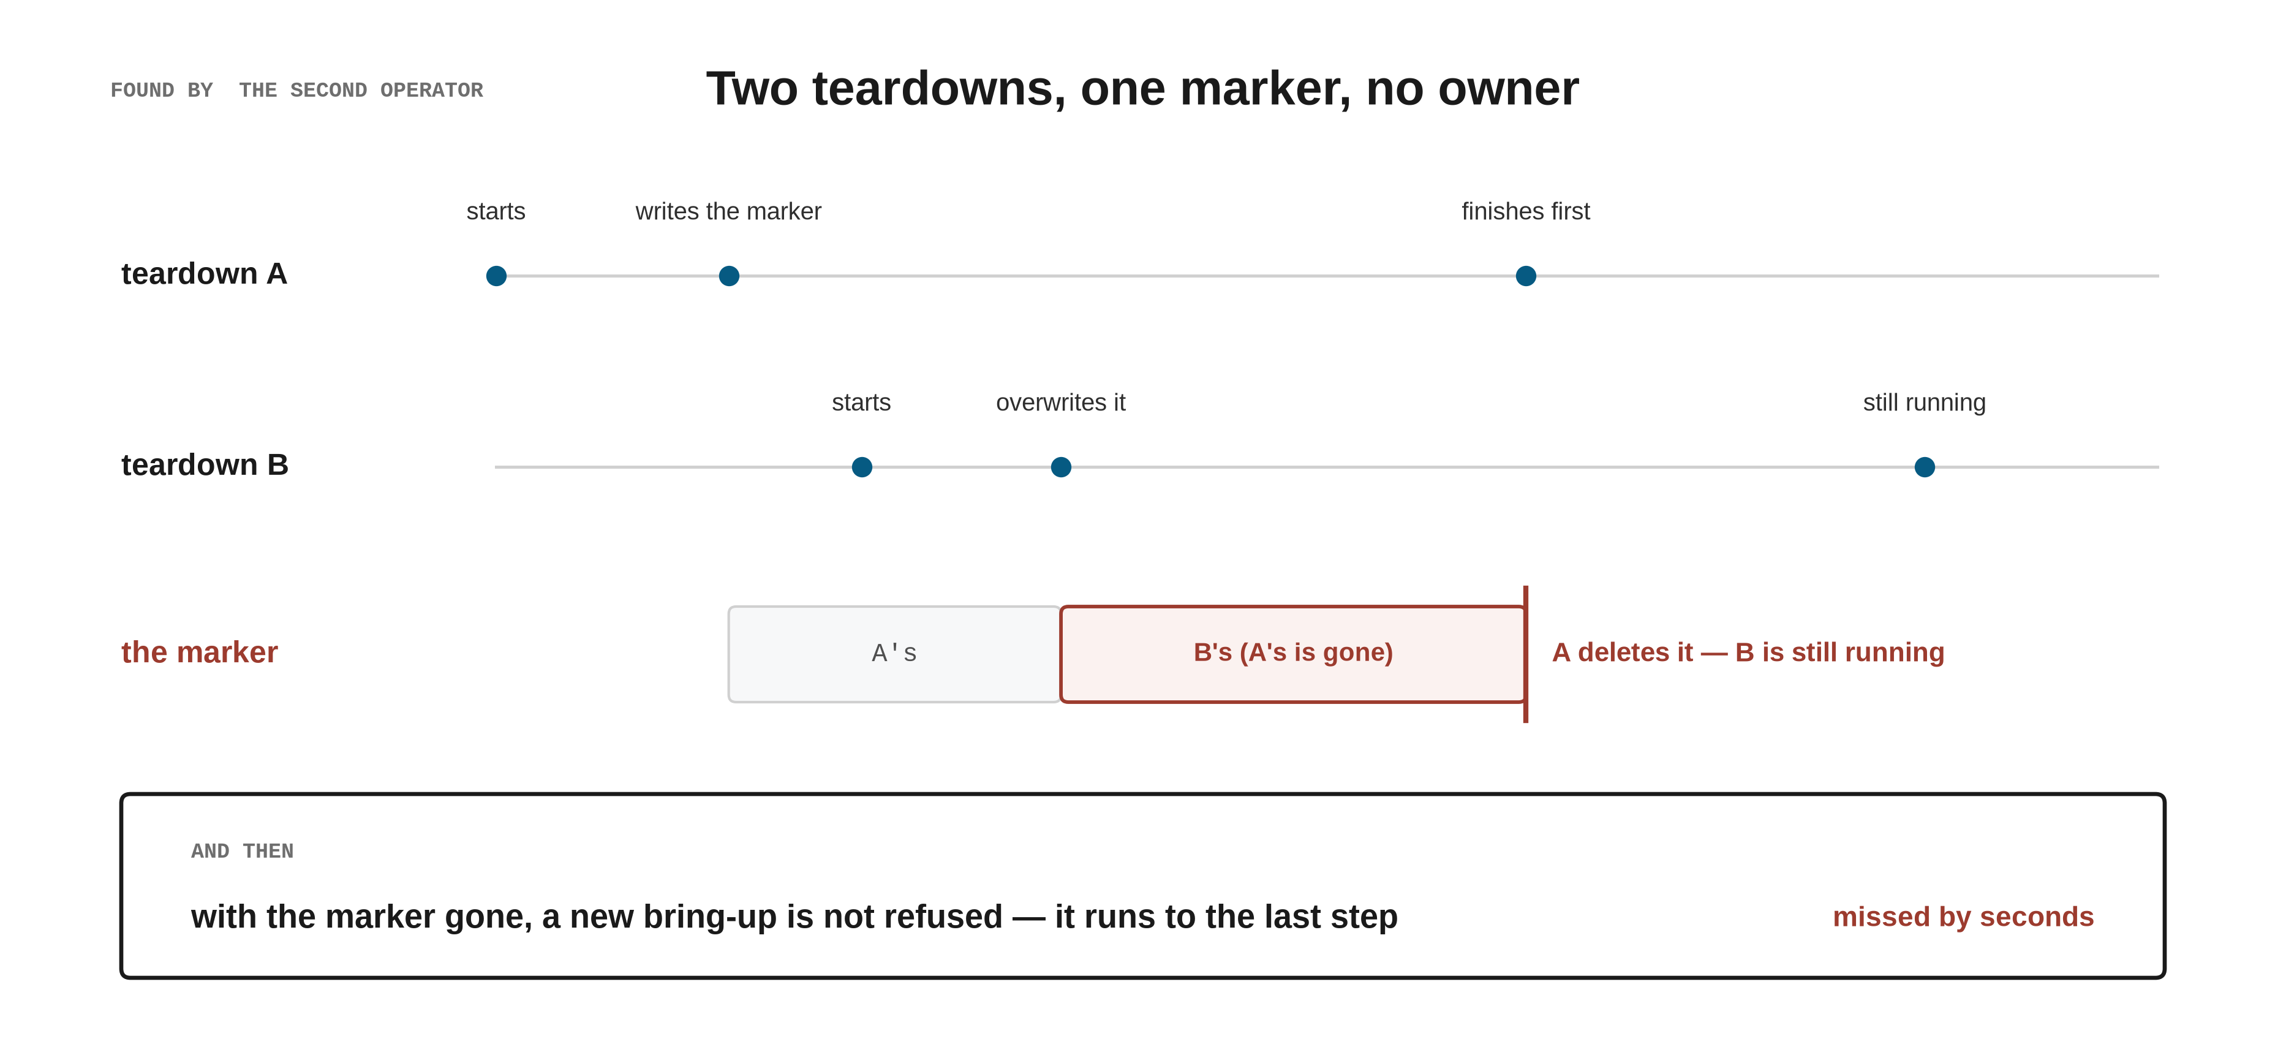
3 · WHAT THE ROLES FOUND
19

Slide 20
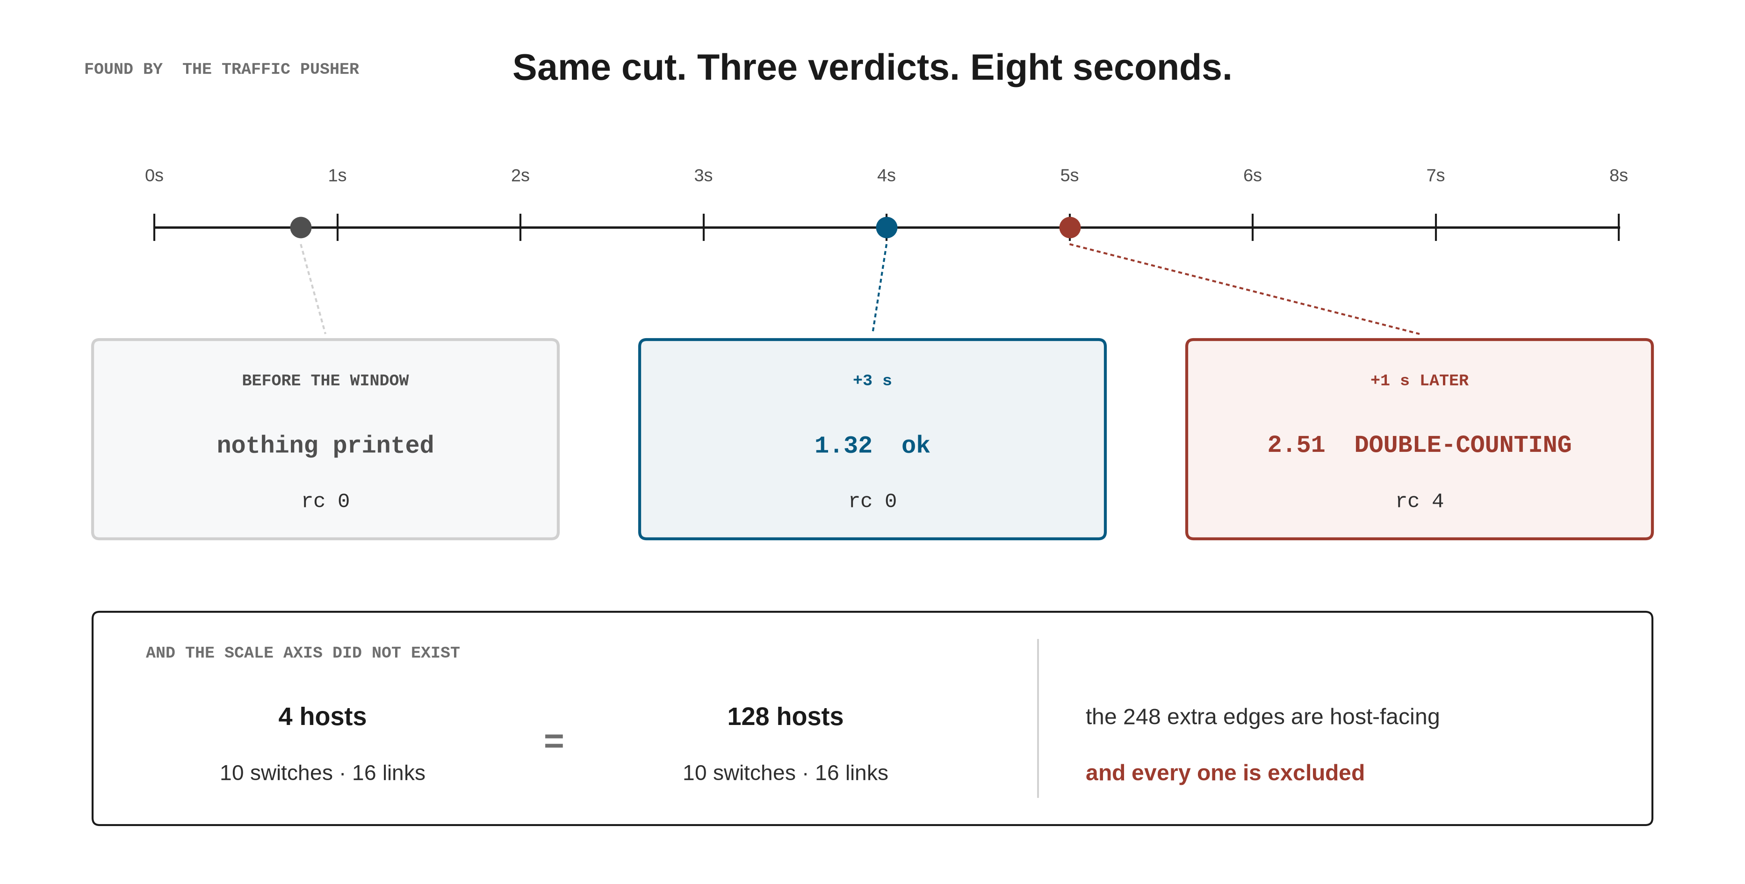
3 · WHAT THE ROLES FOUND
20

Slide 21
4 · BASELINE DEFECTS WE FIXED
ONE FLAG, TWO MEANINGS
who writes is_up | what they mean by it
the power API — powerOff, after the helper confirms the process is dead | a decision: I commanded it off
the 1 Hz liveness worker, and the topology poll | an observation: it answers
what one bit cost | measured
is_up written back to true | 0.3–1.5 s after the command
and it stays true | 8–13 s · 18 of 18 across both arms
two equally dead switches | commanded reads OFF · crashed reads ON
the check for “something died” | reads the same bit on both sides — it can never fire
the ruling | admin_state (command) + reachable (probe)
status | on trunk since 09-05, and published
Live two-arm run, 9 each, at 7e8d91e0 (merged 85c1a159); raw at audit-raw 19e3ab88. Ruling at b57736cd; on trunk via cdc8dad9.
21

Slide 22
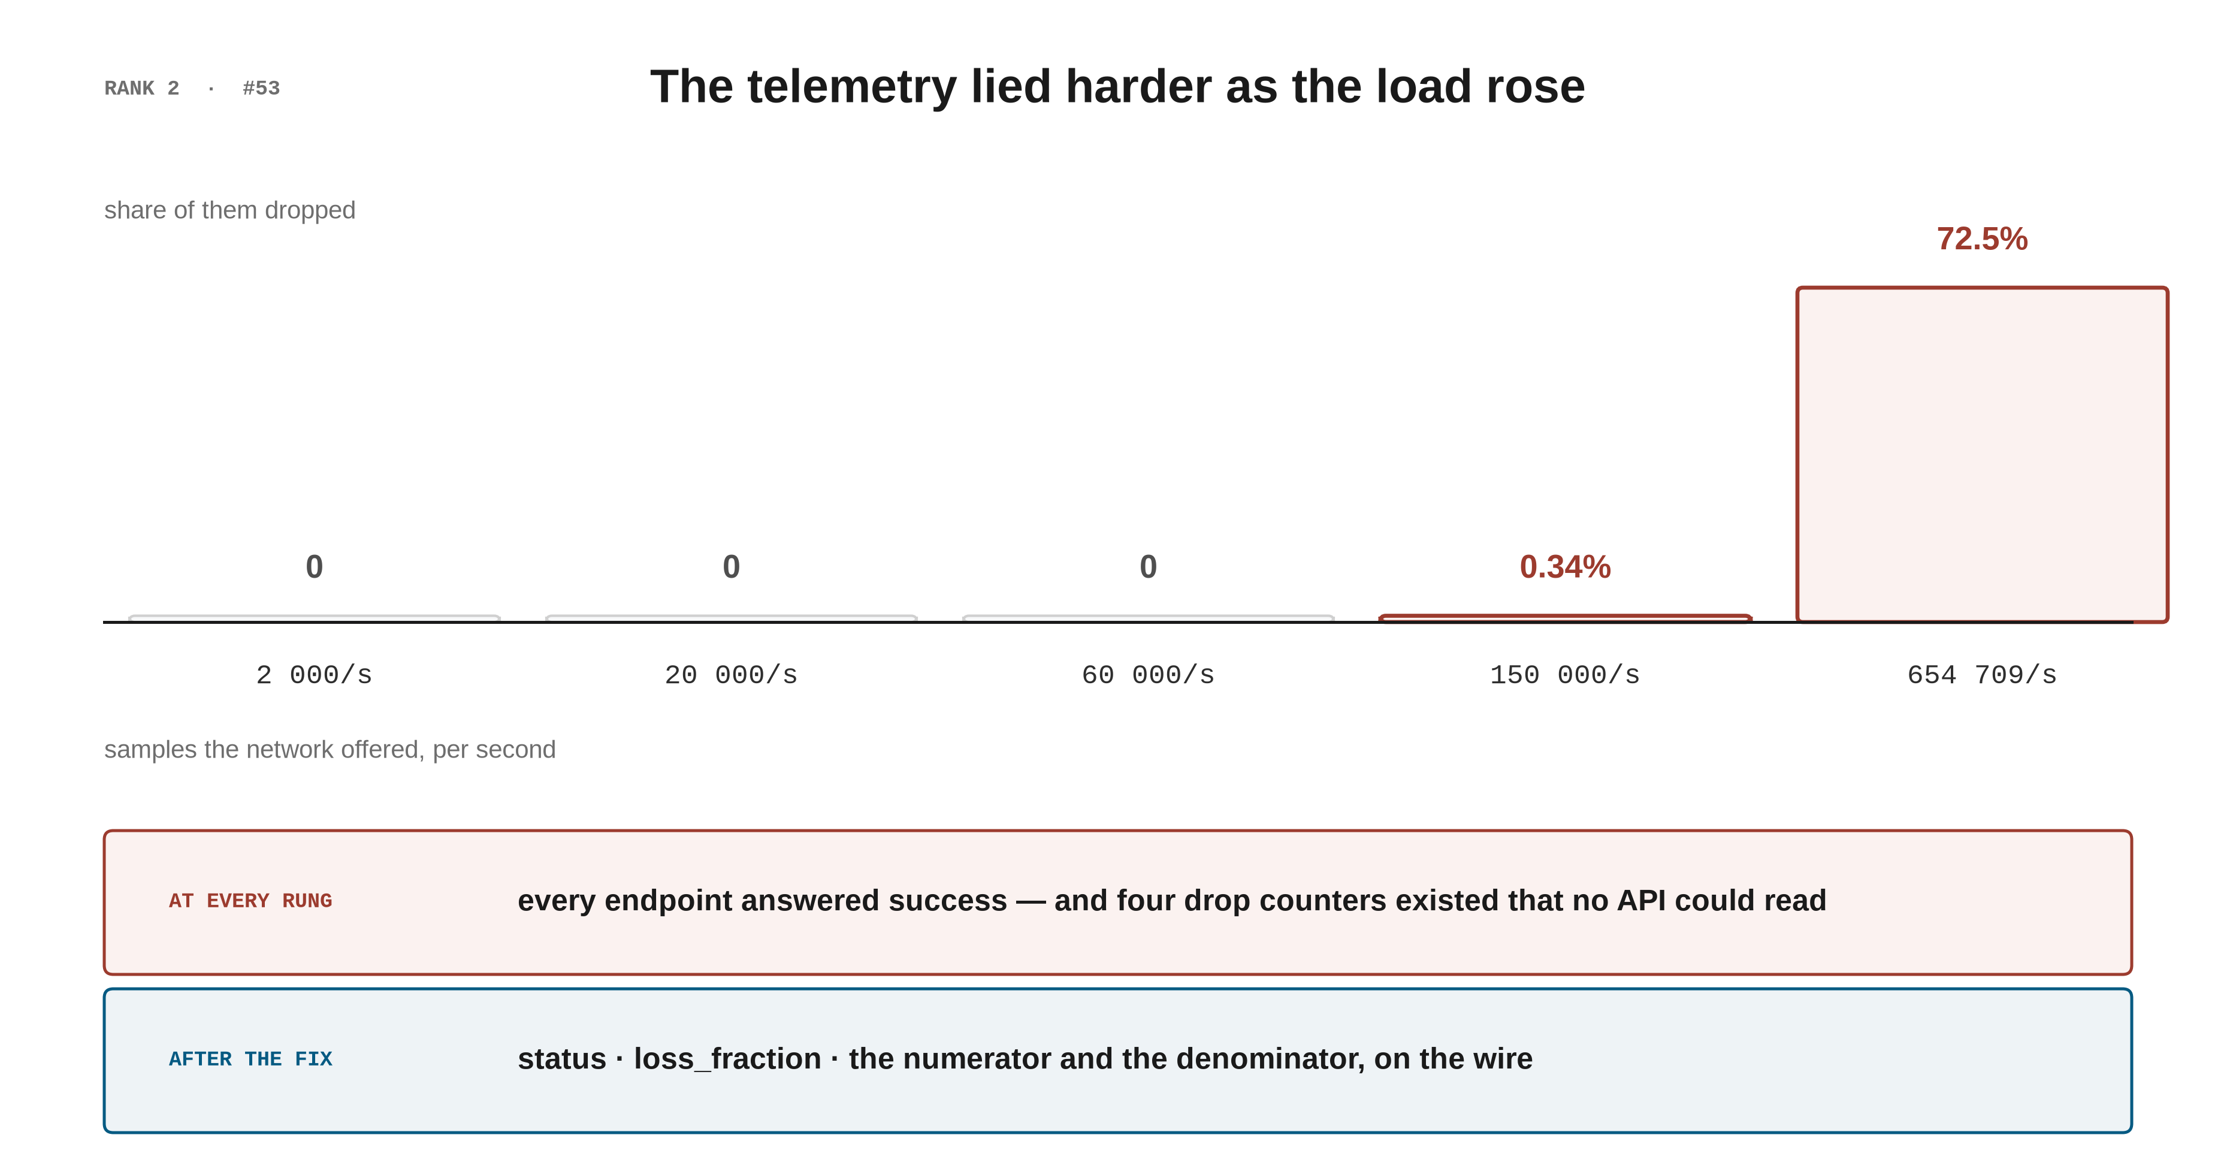
4 · BASELINE DEFECTS WE FIXED
22

Slide 23
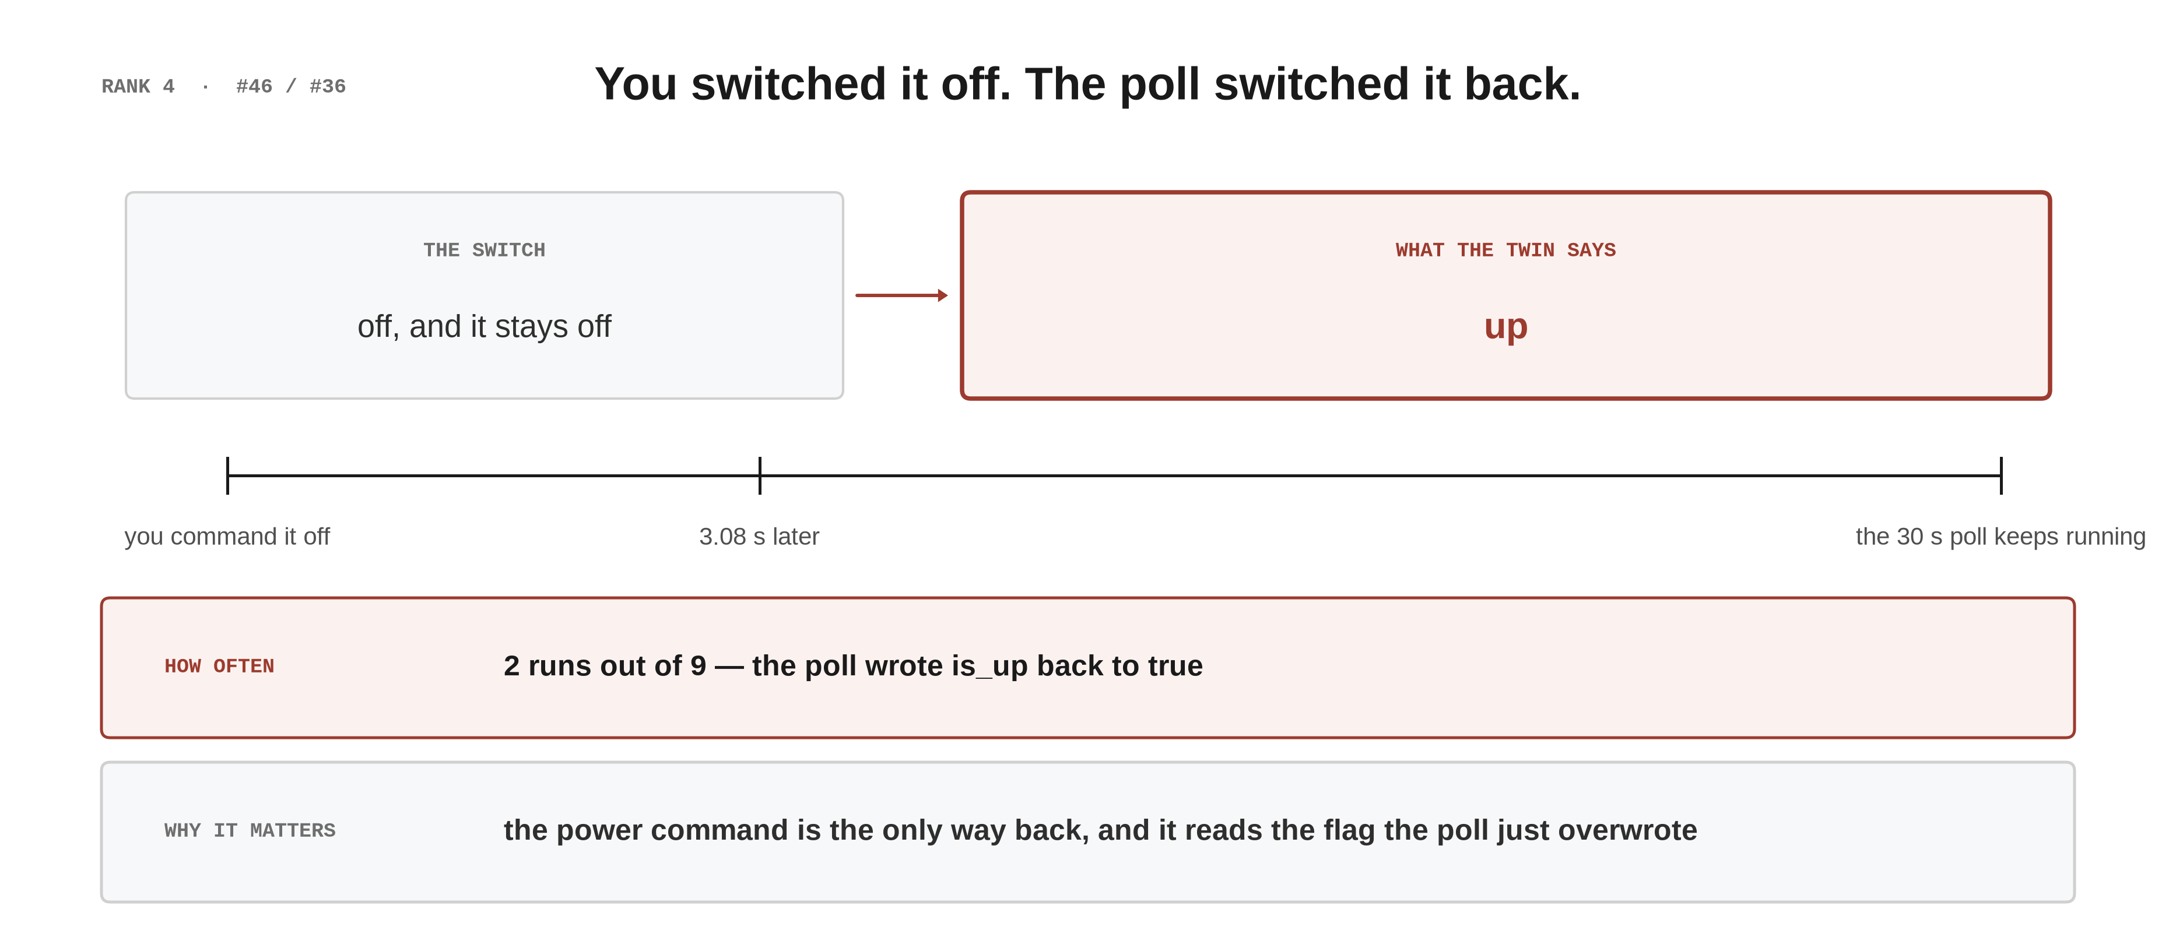
4 · BASELINE DEFECTS WE FIXED
23

Slide 24
4 · BASELINE DEFECTS WE FIXED
24

Slide 25
4 · BASELINE DEFECTS WE FIXED
25

Slide 26
4 · BASELINE DEFECTS WE FIXED
26

Slide 27
4 · BASELINE DEFECTS WE FIXED
27

Slide 28
4 · BASELINE DEFECTS WE FIXED
28

Slide 29
4 · BASELINE DEFECTS WE FIXED
29

Slide 30
4b · MEASURED 09-04 · BEFORE THE FIX
30

Slide 31
4b · MEASURED 09-04 · BEFORE THE FIX
31

Slide 32
4b · MEASURED 09-04 · BEFORE THE FIX
32

Slide 33
4b · MEASURED 09-04 · BEFORE THE FIX
33

Slide 34
4 · BASELINE DEFECTS WE FIXED
34

Slide 35
5 · THE TOOL WE BUILT — NOT BASELINE
35

Slide 36
5 · THE TOOL WE BUILT — NOT BASELINE
36

Slide 37
5 · THE TOOL WE BUILT — NOT BASELINE
37

Slide 38
5 · THE TOOL WE BUILT — NOT BASELINE
38

Slide 39
5 · THE TOOL WE BUILT — NOT BASELINE
39

Slide 40
5 · THE TOOL WE BUILT — NOT BASELINE
40

Slide 41
5 · THE TOOL WE BUILT — NOT BASELINE
41

Slide 42
5 · THE TOOL WE BUILT — NOT BASELINE
42

Slide 43
5 · THE TOOL WE BUILT — NOT BASELINE
43

Slide 44
6 · WHERE IT STANDS
44

Slide 45
6 · WHERE IT STANDS
WHERE IT STANDS
104 fixes | on trunk, and on the default branch of both public repositories
0 branches | waiting — the 29 that were open on 09-08 all merged on 09-10
phase 1 · ~140 lines | unlocks basic: the first tutorial exercise that would run unchanged
Public status cross-checked two ways on 09-15: unauthenticated compare API reports behind_by 0 for both repositories. A single git ls-remote returned a stale answer and is not sufficient on its own.
45

Slide 46
6 · WHERE IT STANDS
WHAT THIS METHOD ADMITS ABOUT ITSELF
the limit | in its own words
reconnaissance guesses wrong a lot | hypotheses are read out of source by an agent that has run nothing · 09-11: 27 confirmed, 12 refuted, 8 unreachable
instruments certify themselves | three in one night — a miscount, a colour code splitting a token, a scan matching itself ⇒ prove the instrument can see a known thing before believing its zero
a fix can be worse than the defect | one rewrote the note to read “lab free”, so the lab declared itself empty while carrying traffic
green does not mean verified | “a grid read as the fixes are verified is worse than no grid” — the coverage table answers who is fixing, not whether it is fixed
coverage skews toward what we were told | if a whole night's findings land inside the five things he pointed at, the tests only walked his path
most role findings are not independently re-run | the live numbers are the role's own; the person filing them did not repeat the measurement
the dispatches and raw are not in version control | scratch/ is git-ignored, so this batch's tickets, reports and logs do not travel with the repository
46

Slide 47
6 · WHERE IT STANDS
47

